Slide 1
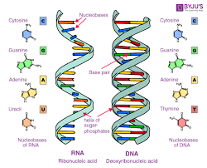
Structure of Biomolecules & their metabolism
Nucleic acids:
-DNA
-RNA
Department of Bioinformatics, G N Khalsa College

Slide 2
1
DNA
???????
RNA
???????
Notes:
The illustration is a ‘model’ of the double helix forming part of a DNA molecule
(Slide 14)

Slide 3
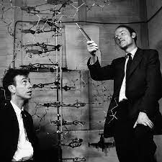
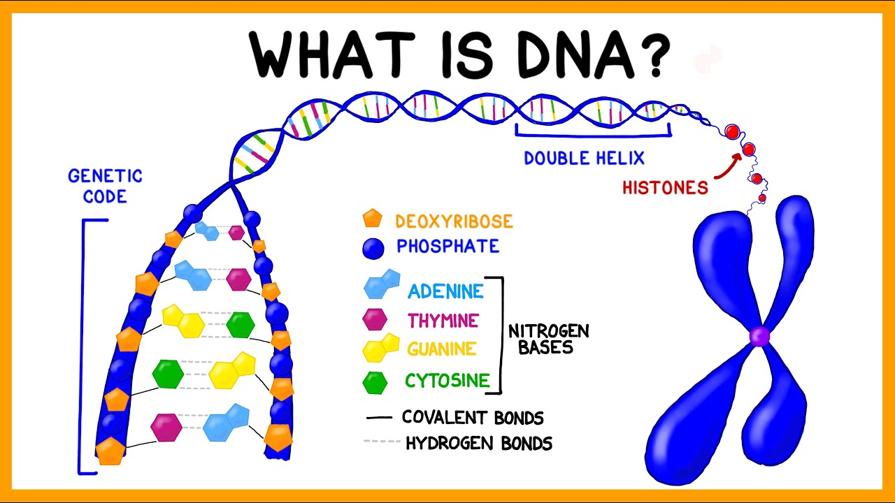
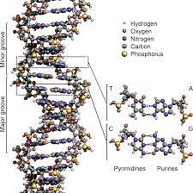
Watson & Crick model

Slide 4
Base Pairing in DNA: The Watson–Crick Model
In 1953 Watson and Crick noted that DNA consists of two polynucleotide strands, running in opposite directions and coiled around each other in a double helix
Strands are held together by hydrogen bonds between specific pairs of bases
Adenine (A) and thymine (T) form strong hydrogen bonds to each other but not to C or G
(G) and cytosine (C) form strong hydrogen bonds to each other but not to A or T

Slide 5
The Difference in the Strands
The strands of DNA are complementary because of H-bonding
Whenever a G occurs in one strand, a C occurs opposite it in the other strand
When an A occurs in one strand, a T occurs in the other

Slide 6
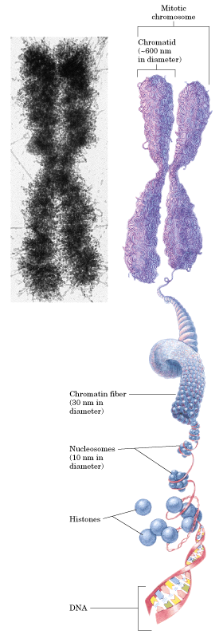

Slide 7
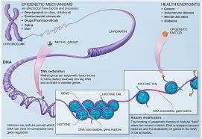
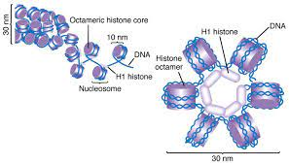
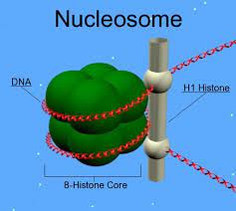

Slide 8
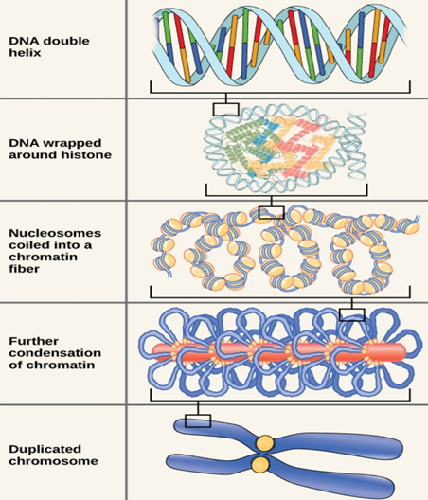

Slide 9
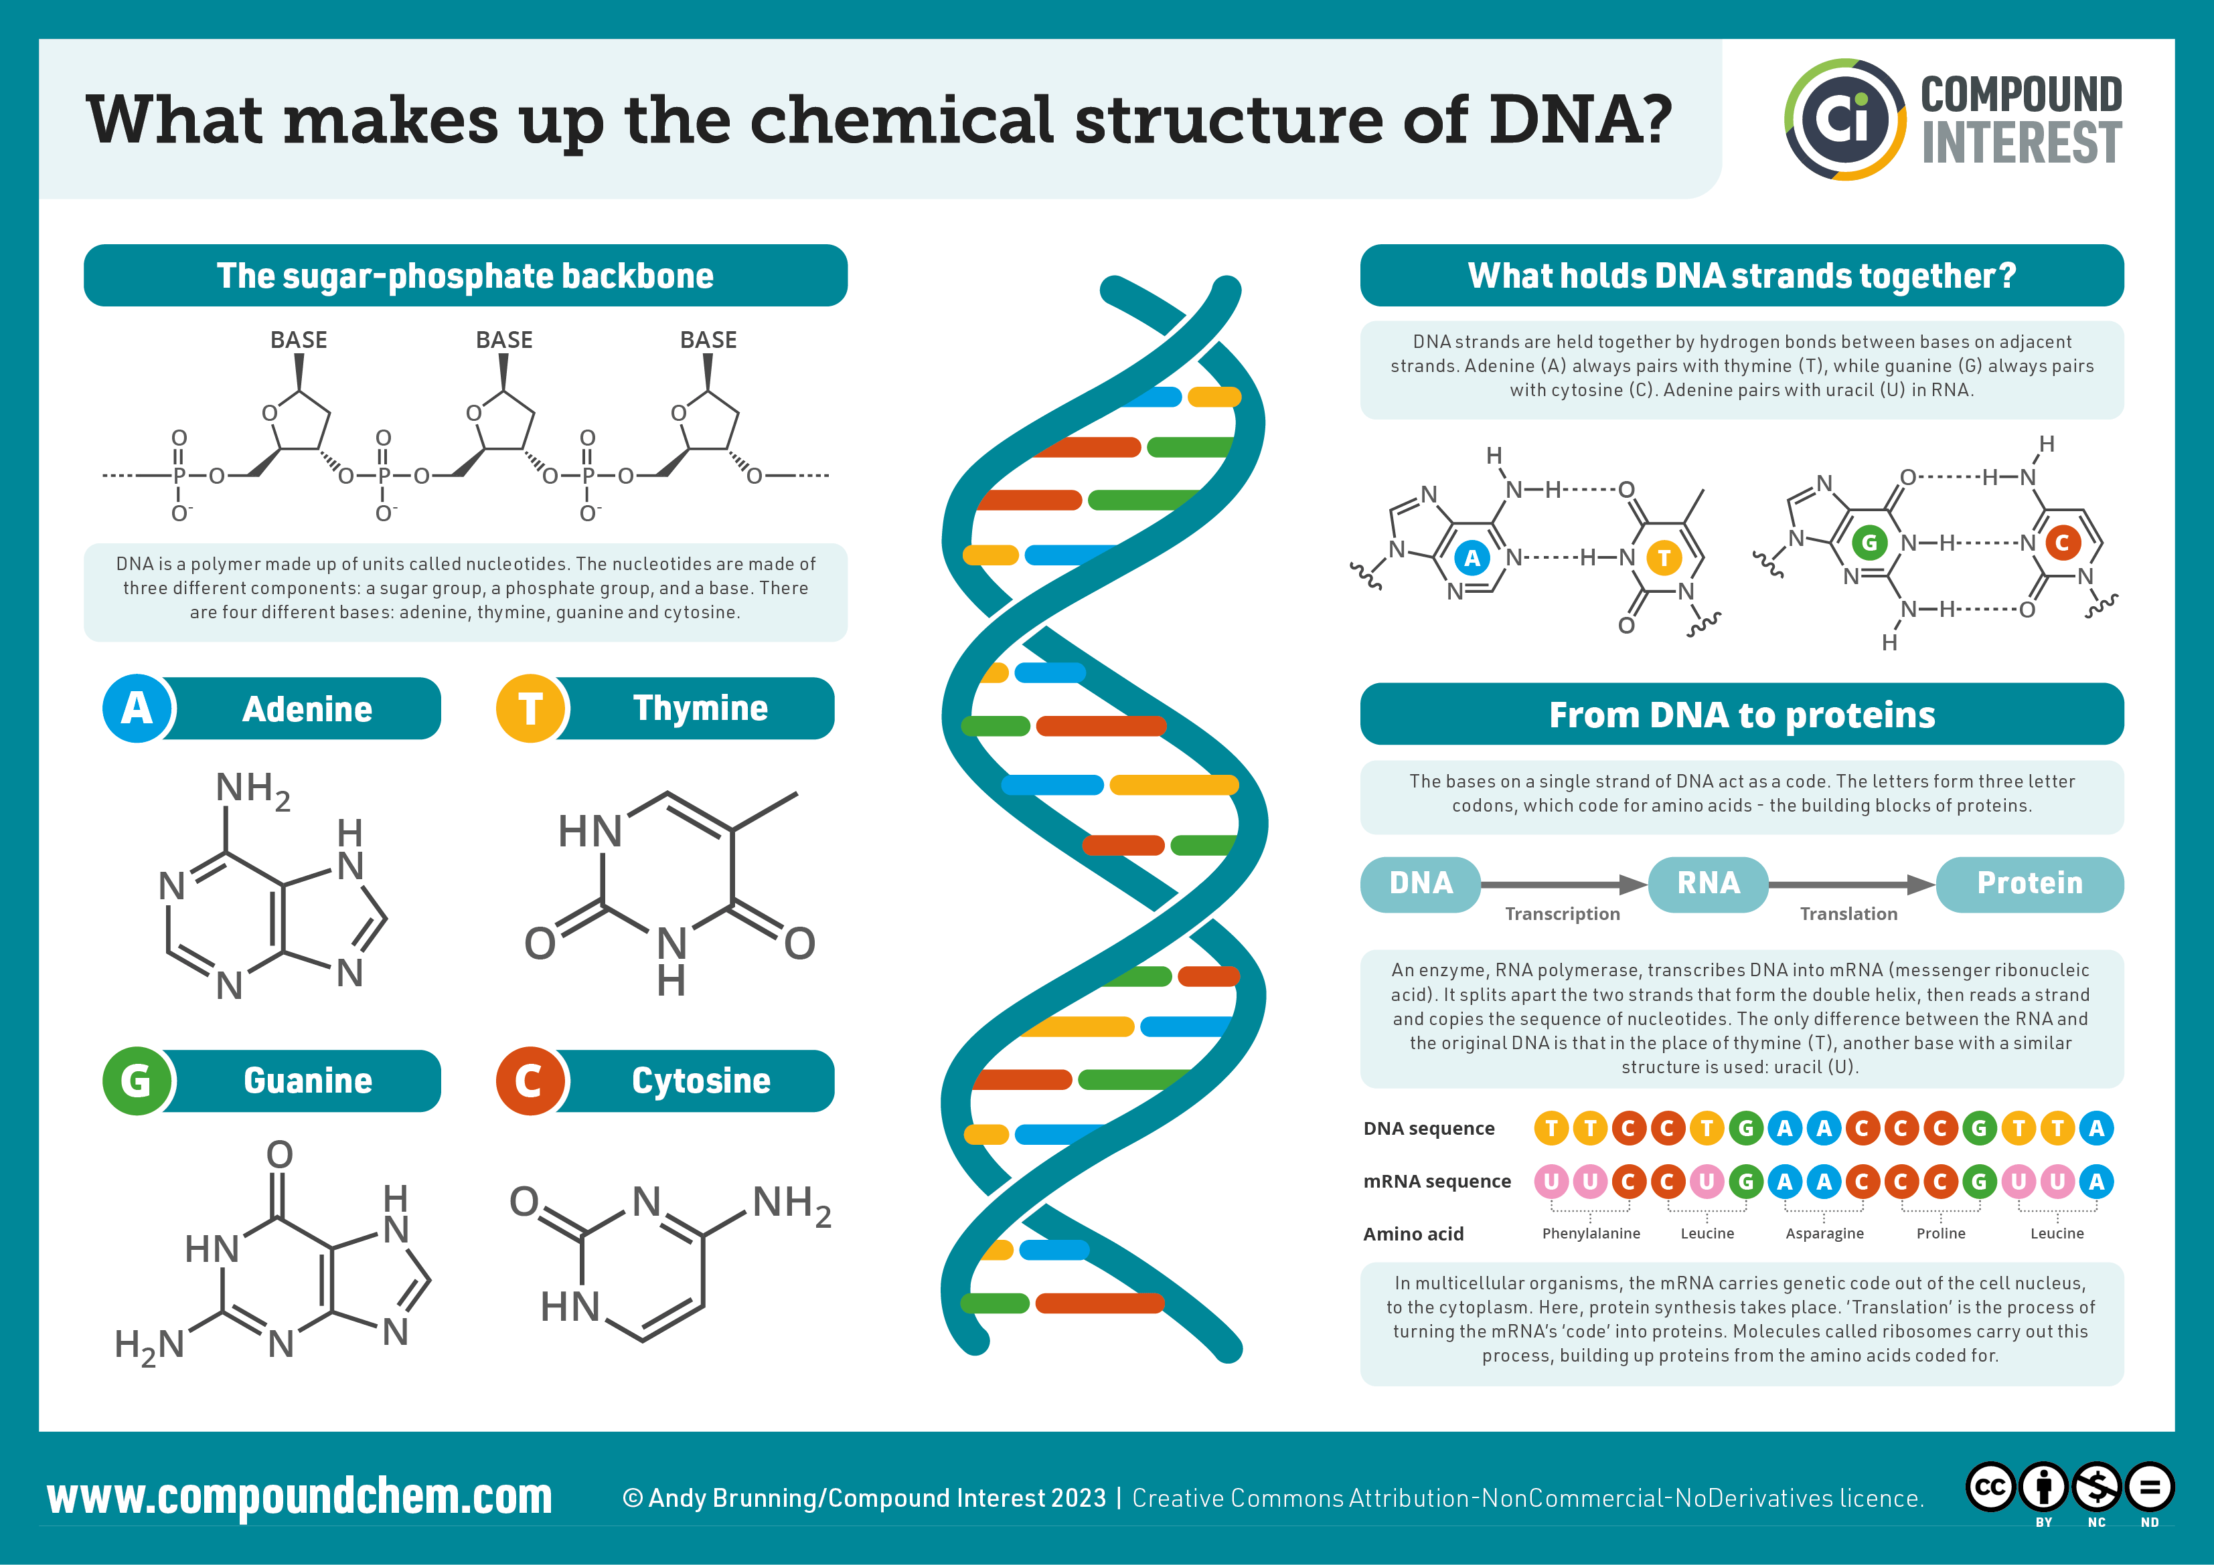

Slide 10
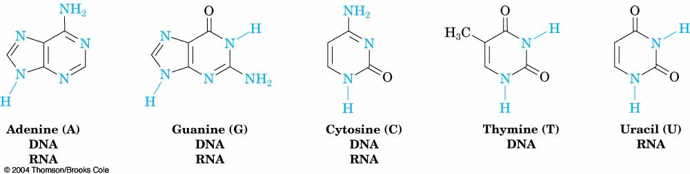
Heterocycles in DNA and RNA
Adenine, guanine, cytosine and thymine are in DNA
RNA contains uracil rather than thymine

Slide 11
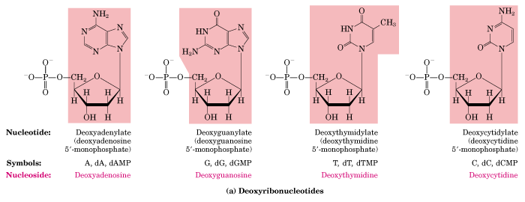
Deoxyribonucleotides found in DNA
dA
dG
dT
dC

Slide 12
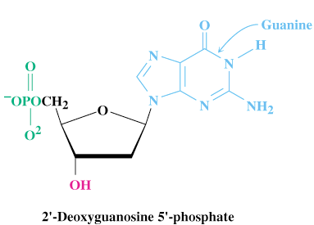
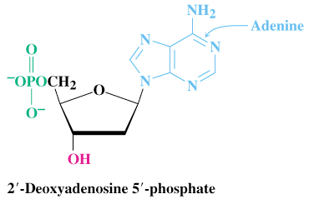
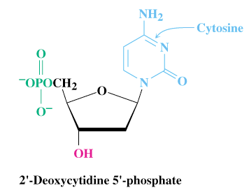
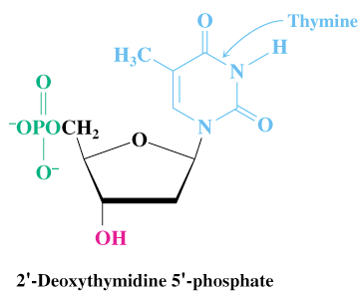
The Deoxyribonucleotides

Slide 13
How DNA Works
1- DNA stores genetic information in segments called genes
2- The DNA code is in Triplet Codons (short sequences of 3 nucleotides each)
3- Certain codons are translated by the cell into certain Amino
acids.
4. Thus, the sequence of nucleotides in DNA indicate a sequence of Amino acids in a protein.

Slide 14
Transcription of RNA from DNA
Only one of the two DNA strands is transcribed into mRNA
The strand that contains the gene is the coding or sense strand
The strand that gets transcribed is the template or antisense strand
The RNA molecule produced during transcription is a copy of the coding strand (with U in place of T)

Slide 15
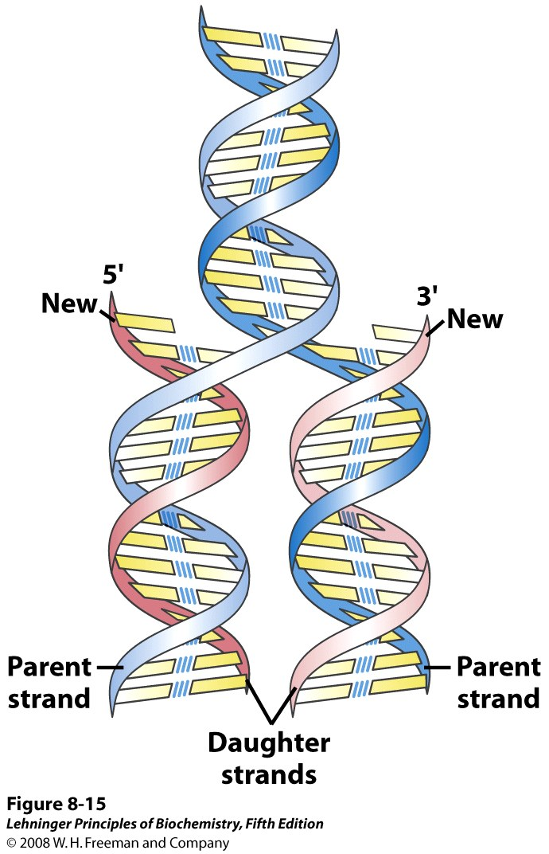
Notes:
FIGURE 8-15 Replication of DNA as suggested by Watson and Crick. The preexisting or "parent" strands become separated, and each is the template for biosynthesis of a complementary "daughter" strand (in pink).

Slide 16
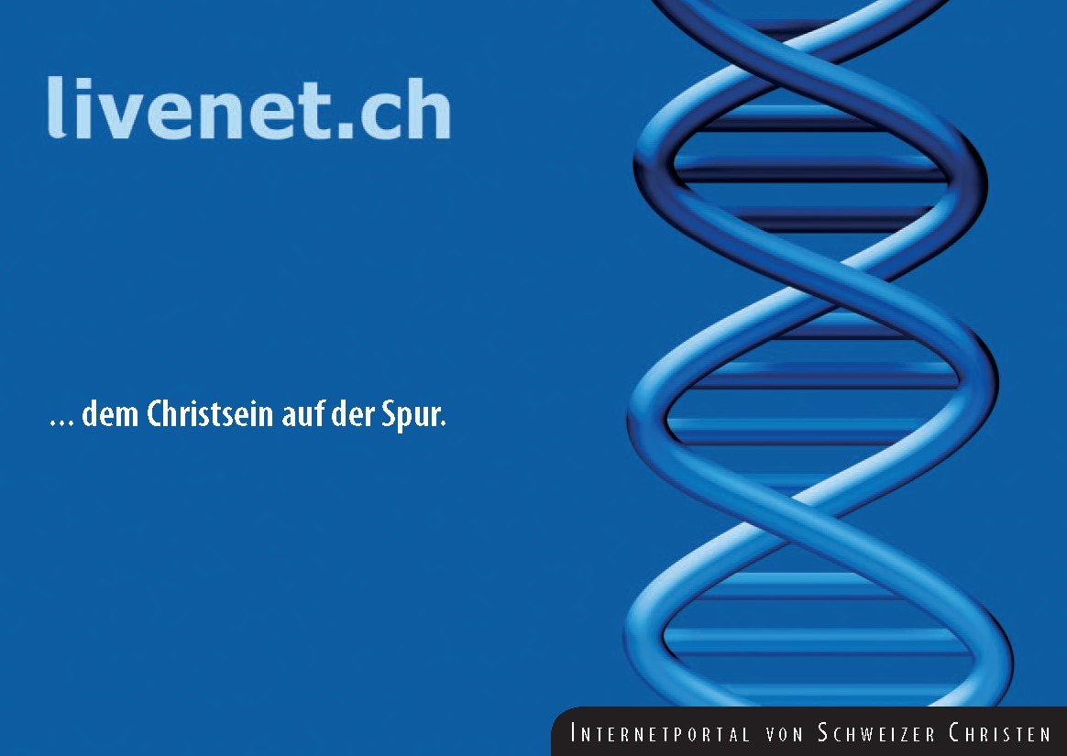
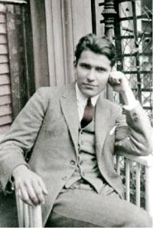
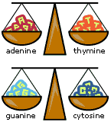
Discovering the structure of DNA
Erwin Chargaff – (1905-2002)
Columbia University, NY
Investigated the composition of DNA
His findings by 1950 strongly
suggested the base-pairings
of A-T & G-C
Met with Watson and Crick in
1952 and shared his findings
“Chargaff’s rule” A = T & C = G

Slide 17
Nucleic Acid Structure
The double helix
First determined by Watson & Crick in 1953
Most energy favorable conformation for double stranded DNA to form
Shape and size is uniform for all life (i.e. DNA is identical)
Without anti-parallel base pairing this conformation could not exist
Structure consists of “major” grooves and “minor” grooves
Major grooves are critical for binding proteins that regulate DNA function

Slide 18
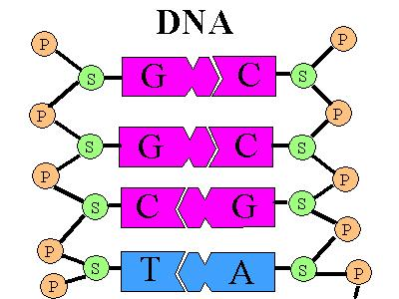
Discovering the structure of DNA
DNA = Deoxyribose nucleic acid
Present in all living cells
Contains all the information
Nucleotides:
a subunit that consists of:
a sugar (deoxyribose)
a phosphate
and one nitrogen base – 4 different bases
Adenine (A) and Thymine (T)
Guanine (G) and Cytosine (C)

Slide 19
DNA
DNA stands for deoxyribose nucleic acid
This chemical substance is present in the nucleus
of all cells in all living organisms
DNA controls all the chemical changes which
take place in cells
The kind of cell which is formed, (muscle, blood,
nerve etc) is controlled by DNA
The kind of organism which is produced is controlled by DNA

Slide 20
DNA molecule
DNA is a very large molecule made up of a long
chain of sub-units
The sub-units are called nucleotides
Each nucleotide is made up of
a sugar called deoxyribose
a phosphate group -PO₄ and
an organic base

Slide 21
Ribose & deoxyribose
Ribose is a sugar, like glucose, but with only five
carbon atoms in its molecule
Deoxyribose is almost the same but lacks one
oxygen atom
Both molecules may be represented by the symbol

Slide 22
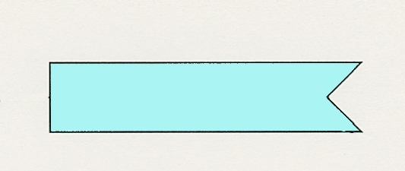
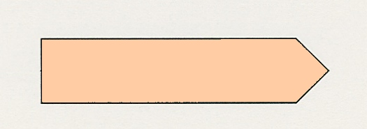
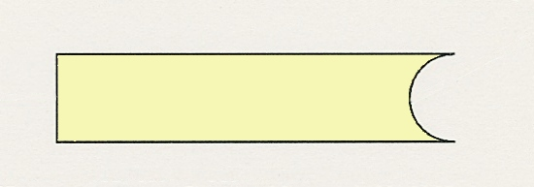
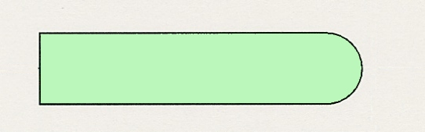
The bases
The most common organic bases are
Adenine
(A)
Thymine
(T)
Cytosine
(C)
Guanine
(G)

Slide 23
Nucleotides
The deoxyribose,
the phosphate
and one of the bases
Combine to form a nucleotide
PO₄
adenine
deoxyribose
Notes:
It is the phosphate group which gives DNA its acidic properties

Slide 24
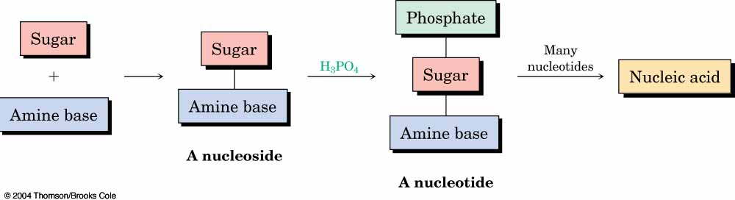
Deoxyribonucleic acid (DNA) and ribonucleic acid (RNA), are the chemical carriers of genetic information
Nucleic acids are biopolymers made of nucleotides, aldopentoses linked to a purine or pyrimidine and a phosphate

Slide 25
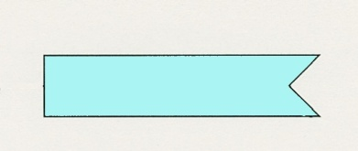
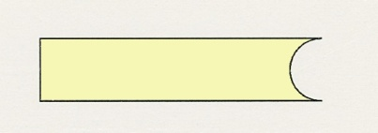
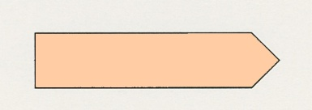

Joined nucleotides
PO₄
A molecule of DNA is formed by millions of nucleotides joined together in a long chain
PO₄
PO₄
PO₄
sugar-phosphate
backbone
+ bases

Slide 26
In fact, the DNA usually consists of a double
strand of nucleotides
The sugar-phosphate chains are on the outside
and the strands are held together by chemical
bonds between the bases

Slide 27
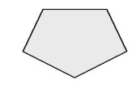
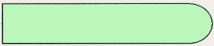
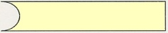

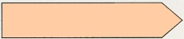
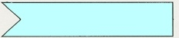

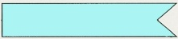
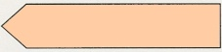

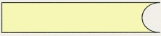
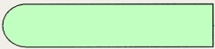



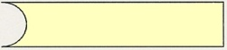

2-stranded DNA
PO₄
PO₄
PO₄
PO₄
PO₄
PO₄
PO₄
PO₄
PO₄
PO₄
PO₄
PO₄
PO₄
PO₄
PO₄
PO₄

Slide 28
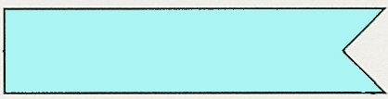
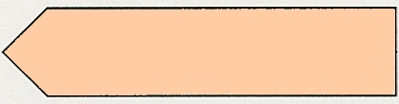
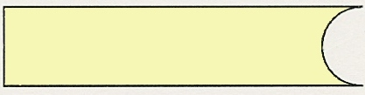
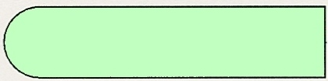
Bonding 1
The bases always pair up in the same way
Adenine forms a bond with Thymine
Adenine
Thymine
and Cytosine bonds with Guanine
Cytosine
Guanine

Slide 29

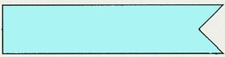
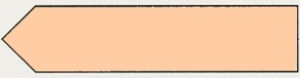
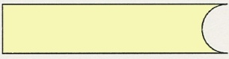
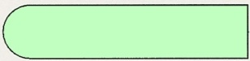

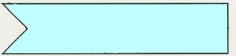

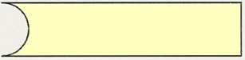
Bonding 2
PO₄
PO₄
adenine
thymine
PO₄
PO₄
cytosine
guanine
PO₄
PO₄
PO₄
PO₄

Slide 30
Pairing up
PO₄
PO₄
PO₄
PO₄
PO₄
PO₄
PO₄
PO₄
PO₄
PO₄
PO₄
PO₄
PO₄
PO₄
PO₄
PO₄

Slide 31
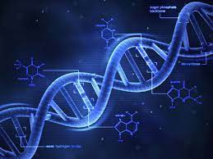
The paired strands are coiled into a spiral called
A DOUBLE HELIX

Slide 32

THE DOUBLE HELIX
14
bases
sugar-phosphate
chain

Slide 33
replication
Before a cell divides, the DNA strands unwind
and separate
Each strand makes a new partner by adding
the appropriate nucleotides
The result is that there are now two double-stranded DNA molecules in the nucleus
So that when the cell divides, each nucleus
contains identical DNA
This process is called replication

Slide 34
The strands separate
PO₄
PO₄
PO₄
PO₄
PO₄
PO₄
PO₄
PO₄
PO₄
PO₄
PO₄
PO₄
PO₄
PO₄
PO₄
PO₄

Slide 35

























Each strand builds up its partner by adding the appropriate nucleotides
PO₄
PO₄
PO₄
PO₄
PO₄
PO₄
PO₄
PO₄
PO₄
PO₄
PO₄
PO₄
PO₄
PO₄
PO₄
PO₄
PO₄
PO₄
PO₄
PO₄
PO₄
PO₄
PO₄
PO₄
PO₄
PO₄
PO₄
PO₄
PO₄
PO₄
PO₄
PO₄
Notes:
The nucleotides are present in the nucleoplasm. The nuclear equivalent of cytoplasm

Slide 36
Genetic code 1
The sequence of bases in DNA forms the
Genetic Code
A group of three bases (a triplet) controls
the production of a particular amino acid in
the cytoplasm of the cell
The different amino acids and the order in which they are joined up determines the sort of protein being produced

Slide 37
Genetic code 2
This is a small, imaginary protein molecule showing
how a sequence of 5 different amino acids could determine the shape and identity of the molecule
Ser-Cyst-Val-Gly-Ser-Cyst Ala
Val
Val-Cyst-Ser-Ala-Ser-Cyst-Gly
Val- Cyst-Ala-Ala-Ser-Gly
Each amino acid (Serine, Cysteine, Valine, Glycine and
Alanine) is coded for by a particular triplet of bases

Slide 38
Coding
For example
Cytosine
Adenine
Codes for
Valine
Thymine
Cytosine (C)
Codes for
Alanine
Guanine (G)
Adenine (A)

Slide 39
Triplet code
This is known as the triplet code
Each triplet codes for a specific amino acid
CGA - CAA - CCA - CCA - GCT - GGG - GAG - CCA -
Ala
Val
Gly
Gly
Arg
Pro
Leu
Gly
The amino acids are joined together in the correct
sequence to make part of a protein
Ala
Val
Gly
Gly
Arg
Pro
Leu
Gly
Notes:
Although the DNA in the nucleus specifies the amino acids and their sequence, it is in the cytoplasm that the protein build-up takes place. The DNA of the nucleus makes a single strand of messenger RNA (ribo-nucleic acid) which leaves the nucleus and builds up the protein in the cytoplasm. The RNA code is complementary, but not identical, to the nuclear DNA. Text books usually give the coding for the RNA but in this presentation it is for the DNA itself

Slide 40
Triplet code
This is known as the triplet code
Each triplet codes for a specific amino acid
CGA - CAA - CCA - CCA - GCT - GGG - GAG - CCA -
Ala
Val
Gly
Gly
Arg
Pro
Leu
Gly
The amino acids are joined together in the correct
sequence to make part of a protein
Ala
Val
Gly
Gly
Arg
Pro
Leu
Gly
Notes:
Although the DNA in the nucleus specifies the amino acids and their sequence, it is in the cytoplasm that the protein build-up takes place. The DNA of the nucleus makes a single strand of messenger RNA (ribo-nucleic acid) which leaves the nucleus and builds up the protein in the cytoplasm. The RNA code is complementary, but not identical, to the nuclear DNA. Text books usually give the coding for the RNA but in this presentation it is for the DNA itself

Slide 41

mRNA Codons and Associated Amino Acids

Slide 42
Reading the Genetic Code
Suppose we want to determine the amino acids coded for in the following section of a mRNA
5’—CCU —AGC—GGA—CUU—3’
According to the genetic code, the amino acids for these codons are:
CCU = Proline AGC = Serine
GGA = Glycine CUU = Leucine
The mRNA section codes for the amino acid sequence of Pro—Ser—Gly—Leu

Slide 43
DNA and enzymes
The proteins build the cell structures
They also make enzymes
The DNA controls which enzymes are made and
the enzymes determine what reactions take place
The structures and reactions in the cell determine
what sort of a cell it is and what its function is
So DNA exerts its control through the enzymes

Slide 44
Genes
A sequence of triplets in the DNA molecule may
code for a complete protein
Such a sequence forms a gene
There may be a thousand or more bases in
one gene

Slide 45



Slide 46


Structural Variation in DNA
Double-helical DNA is a very flexible molecule. Considerable rotation is possible around several types of bonds in the phosphodeoxyribose backbone, and thermal fluctuation can produce bending, stretching, and unpairing (melting) of the strands.
Many significant deviations from the Watson-Crick DNA structure are found in cellular DNA, some or all of which may be important in DNA metabolism. Note that these structural variations generally do not affect the fundamental properties of DNA, such as strand complementarity, antiparallel strands, and the requirement for A/T and G/C base pairs.
Structural variations in DNA are due to three things: the different possible conformations of the deoxyribose, rotation about the contiguous bonds that make up the phosphodeoxyribose backbone, and free rotation about the C-1’-N-glycosyl bond (Fig. 8-16b). Because of steric constraints, purines in purine nucleotides are restricted to two stable conformations with respect to deoxyribose, called syn and anti.
Pyrimidines generally are restricted to the anti conformation because of steric interference between the sugar and the carbonyl oxygen at C-2 of the pyrimidine.

Slide 47

The A, B, and Z Forms of DNA
The Watson-Crick structure of DNA is also referred to as B-form DNA, or B-DNA.
B-DNA is the most stable structure for a random-sequence DNA molecule under physiological conditions and is therefore the standard structural reference in any study of the properties of DNA.
Two structural variants that have been well characterized in crystal structures are the A- and Z-forms of DNA.
In general, A-DNA is a dehydrated form of DNA that may not occur in cells.
A similar type of structure does occur in double helical RNA. There is evidence for some short tracts of Z-DNA in bacterial and eukaryotic cells. These Z-DNA tracts may play a role (as yet unidentified) in regulating the expression of some genes or in genetic recombination.

Slide 48

The A, B, and Z Forms of DNA
The DNA backbone of Z-DNA takes on a zigzag conformation. Certain nucleotide sequences fold into left-handed Z helices much more readily than others.
Prominent examples are sequences in which pyrimidines alternate with purines, especially alternating C and G or 5-methyl-C and G residues. To form the left-handed helix in Z-DNA, the purine residues flip to the syn conformation, alternating with pyrimidines in the anti conformation.

Slide 49

DNA Palindromes and Mirror Repeats
It is thought that other sequence-dependent structural variations found in larger chromosomes may affect the function and metabolism of the DNA segments in their immediate vicinity. A rather common type of such DNA sequence is a palindrome.
A palindrome is a word, phrase, or sentence that is spelled identically read either forward or backward.
A example is the word ROTATOR. The term is applied to regions of DNA with inverted repeats of base sequence having twofold symmetry over two strands of DNA. Such sequences have the potential to form unique DNA structures. When the inverted repeat occurs within each individual strand of the DNA, the sequence is called a mirror repeat. Mirror repeats cannot form the same types of structures as DNA palindromes.

Slide 50


DNA Palindromes and Mirror Repeats (II)
DNA palindromes are self-complementary within each strand and therefore have the potential to form hairpin and cruciform (cross-shaped) structures.
Sequences of these types are found in virtually every large DNA molecule and can encompass a few base pairs or thousands.
The extent to which palindromes occur in cruciforms in cells is not known, although some cruciform structures have been demonstrated in vivo in E. coli.
Self-complementary sequences cause isolated single strands of DNA (or RNA) in solution to fold into complex structures containing multiple hairpins.

Slide 51


Triple-helical DNA
Several unusual DNA structures involve three or four DNA strands. Nucleotides participating in a Watson-Crick base pair can form additional hydrogen bonds, particularly with functional groups in the major groove.
For example, a cytidine residue if protonated can pair with a guanosine residue of a G/C base pair, and an thymidine can pair with the adenosine of an A/T pair. The N-7, O⁶, and N⁶ of purines are the atoms that participate in the hydrogen bonding of triplex DNA.
These atoms are often referred to as Hoogsteen positions, and the non-Watson-Crick pairing is called Hoogsteen pairing after their discoverer, Karst Hoogsteen. This type of base pairing allows the formation of triplex DNAs.

Slide 52

Triple-helical DNA (II)
Some triplex DNAs contain two pyrimidine strands and one purine strand. Others contain two purine strands and one pyrimidine strand. In Fig. below triple-helical DNA containing two pyrimidine strands (red and white; sequence TTCCT) and one purine strand (blue; sequence AAGGAA) are shown. The blue and white strands are antiparallel and are paired by normal Watson-Crick base pairs. The third (all pyrimidine strand) is parallel to the purine strand and paired through non-Watson-Crick hydrogen bonds. The triplexes shown in Fig. are most stable at low pH because the C/G.C⁺ triplet requires a protonated cytosine. In the triplex, the pK_{a} of this cytosine is >7.5, which is raised considerably from its normal value of 4.2. Triplexes form most readily within long sequences containing only pyrimidines or only purines in a given strand.

Slide 53



Tetraplex DNA
Four DNA strands can also pair to form a tetraplex (quadruplex), but this occurs readily only for DNA sequences with a very high proportion of guanosine residues. The guanosine tetraplex, or G tetraplex, is quite stable over a wide range of conditions. The orientation of strands in the tetraplex can vary as shown in Fig.

Slide 54
RNA Nucleotides Composition ( 3 parts):
1- Ribose sugar (with O in 3rd carbon)
2- Phosphate group
3- One of 4 types of bases (all containing nitrogen):
- Adenine
- Uracyl (only in RNA)
- Cytosine
- Guanine

Slide 55
Ribonucleic Acid (RNA)
RNA is much more abundant than DNA
There are several important differences between RNA and DNA:
- the pentose sugar in RNA is ribose, in DNA it’s deoxyribose
- in RNA, uracil replaces the base thymine (U pairs with A)
- RNA is single stranded while DNA is double stranded
- RNA molecules are much smaller than DNA molecules
There are three main types of RNA:
- ribosomal (rRNA), messenger (mRNA) and transfer (tRNA)

Slide 56

Types of RNA

Slide 57
Messenger RNA (mRNA)
Its sequence is copied from genetic DNA
It travels to ribsosomes, small granular particles in the cytoplasm of a cell where protein synthesis takes place

Slide 58
Ribosomal RNA (rRNA)
Ribosomes are a complex of proteins and rRNA
The synthesis of proteins from amino acids and ATP occurs in the ribosome
The rRNA provides both structure and catalysis

Slide 59
Transfer RNA (tRNA)
Transports amino acids to the ribosomes where they are joined together to make proteins
There is a specific tRNA for each amino acid
Recognition of the tRNA at the anti-codon communicates which amino acid is attached

Slide 60

Transfer RNA
Transfer RNA translates the genetic code from the messenger RNA and brings specific amino acids to the ribosome for protein synthesis
Each amino acid is recognized by one or more specific tRNA
tRNA has a tertiary structure that is L-shaped
- one end attaches to the amino acid and the other binds to the mRNA by a 3-base complimentary sequence

Slide 61

Ribosomal RNA and Messenger RNA
Ribosomes are the sites of protein synthesis
- they consist of ribosomal DNA (65%) and proteins (35%)
- they have two subunits, a large one and a small one
Messenger RNA carries the genetic code to the ribosomes
- they are strands of RNA that are complementary to the DNA of the gene for the protein to be synthesized

Slide 62

RNA Structure
As in the case of protein structure, it is sometimes useful to describe nucleic acid structure in terms of hierarchical levels of complexity (i.e., primary, secondary, and tertiary structure). The primary structure of a nucleic acid is its covalent structure and nucleotide sequence. Any regular, stable structure taken up by some or all of the nucleotides in a nucleic acid can be referred to as secondary structure. The complex folding of large chromosomes within eukaryotic chromatin and the bacterial nucleoid, or the elaborate folding of large tRNA or rRNA molecules, is generally considered tertiary structure. The process by which RNAs are formed on a DNA template is known as transcription. In bacteria, mRNAs can contain the protein coding sequences (red) for one gene (monocistronic) or multiple genes (polycistronic). mRNAs also contain noncoding regions (gray) at their ends and between protein coding sequences that may be involved in regulation of protein synthesis.

Slide 63

Base Stacking in Single-stranded RNA
The product of transcription of DNA is always single-stranded RNA. The single strand tends to assume a right-handed helical conformation dominated by base-stacking interactions.
In this structure the bases are shown in yellow, the phosphorous atoms in orange, and the ribose and phosphate oxygens in green.
Base stacking interactions are stronger between two purines than between a purine and pyrimidine or between two pyrimidines.
The purine-purine interaction is so strong that a pyrimidine separating two purines is often displaced from the stacking pattern so that the purines can interact.

Slide 64

RNA Secondary Structures
Any self-complementary sequences in single-stranded RNAs produce more complex secondary structures. Base pairing in RNA matches the pattern observed for DNA. Namely, G pairs with C, and A pairs with U (or the occasional T residue in some RNAs). One difference is that base pairing between G and U residues is allowed in RNA when complementary sequences in two single strands of RNA pair with each other.
The paired strands in RNA duplexes (or RNA-DNA duplexes) are antiparallel, as in double-helical DNA.
The predominant double-stranded structure is an A-form right-handed double helix.
The B-form double helix has not been observed for RNA. Strands of RNA that are precisely complementary over long regions of sequence are uncommon.
Breaks in the regular A-form RNA double helix caused by mismatched or unmatched bases in one or both strands are common and result in bulges or internal loops. Hairpin loops form between nearly self-complementary (palindromic) sequences.

Slide 65

Three-dimensional Structure in RNA

Slide 67


Slide 68
Living organisms require biomolecules for several biological processes like energy storage and regulation of their metabolic cycles.
Among all, carbohydrates, nucleic acids, lipids, and proteins are the four major biomolecules (or macromolecules) that are mainly involved in these biological processes.

Slide 69
What are Carbohydrates?
Carbohydrate is a group of organic compounds occurring in living tissues and foods in the form of starch, cellulose, and sugars.
The ratio of oxygen and hydrogen in carbohydrates is the same as in water i.e. 2:1. It typically breaks down in the animal body to release energy.
C_{n}(H₂O)_{n} is the generic formula for all carbohydrates. This formula is only valid for simple sugars, which are made up of the same amount of carbon and water.
Carbohydrates (or sugars) were originally believed to be “hydrates of carbon,” because they have the general formula C_{x}(H₂O)y.

Slide 70
sources of energy
intermediates in the biosynthesis of other basic biochemical entities (fats and proteins)
associated with other entities such as glycosides, vitamins and antibiotics)
form structural tissues in plants and in microorganisms (cellulose, lignin, murein)
participate in biological transport, cell-cell recognition, activation of growth factors, modulation of the immune system

Slide 71


Slide 72

Carbohydrates
glucose provides energy for the brain and ½ of energy for muscles and tissues
glycogen is stored glucose
glucose is immediate energy
glycogen is reserve energy
Simple carbohydrates are the basic type of carbs.
Complex carbohydrates represent an important energy source for your body.
They provide the sustained fuel your body needs for exercise, daily living activities and even rest.

Slide 73
Classification of Carbohydrates

Slide 74


Slide 75
Classification of carbohydrates
Carbohydrates – polyhydroxyaldehydes or polyhydroxy-ketones of formula (CH₂O)_{n}, or compounds that can be hydrolyzed to them. (aka sugars or saccharides)
Monosaccharides – carbohydrates that cannot be hydrolyzed to simpler carbohydrates; eg. Glucose or fructose.
Disaccharides – carbohydrates that can be hydrolyzed into two monosaccharide units; eg. Sucrose, which is hydrolyzed into glucose and fructose.
Oligosaccharides – carbohydrates that can be hydrolyzed into a few monosaccharide units.
Polysaccharides – carbohydrates that are are polymeric sugars; eg Starch or cellulose.

Slide 76


Slide 78


Monosaccharides
also known as simple sugars
classified by 1. the number of carbons and 2. whether aldoses or ketoses
most (99%) are straight chain compounds
D-glyceraldehyde is the simplest of the aldoses (aldotriose)
all other sugars have the ending ose (glucose, galactose, ribose, lactose, etc…)

Slide 79
Monosaccharides
Aldoses (e.g., glucose) have an aldehyde group at one end.
Ketoses (e.g., fructose) have a keto group, usually at C2.

Slide 80
The Fischer convention, the basis for the D- configuration in sugars comes from D-glyceraldhyde’s configuration around its asymmetric carbon.
Epimers differ in configuration around one carbon atom i.e. D-glucose and D-mannose but D-glactose and D-glucose are not epimers because they very around two carbon atoms. There are 2^{n-2} stereoisomers

Slide 81

Monosaccharides (D-aldoses)

Slide 82
Sugar Nomenclature
For sugars with more than one chiral center, D or L refers to the asymmetric C farthest from the aldehyde or keto group.
Most naturally occurring sugars are D isomers.

Slide 83
D & L sugars are mirror
images of one another.
They have the same
name, e.g., D-glucose
& L-glucose.
Other stereoisomers
have unique names,
e.g., glucose, mannose,
galactose, etc.
The number of stereoisomers is 2^{n}, where n is the number of asymmetric centers.
The 6-C aldoses have 4 asymmetric centers. Thus there are 16 stereoisomers (8 D-sugars and 8 L-sugars).

Slide 84
D vs L Designation
D & L designations are based on the configuration about the single asymmetric C in glyceraldehyde.
The lower representations are Fischer Projections.

Slide 85


Slide 86
Enantiomres
A special type of isomerism is found in the pairs of structures that are mirror images of each other. These mirror images are called enantiomers, and the two members of the pair are designated as a D- and an L-sugar
Two monosaccharides differ in configuration around only one specific carbon atom (with the exception of the carbonyl carbon, see below), they are defined as epimers of each other.

Slide 87
(+)-glucose? An aldohexose
Emil Fischer (1902)
Four chiral centers, 2⁴ = 16 stereoisomers

Slide 88
Fructose forms either
a 6-member pyranose ring, by reaction of the C2 keto group with the OH on C6, or
a 5-member furanose ring, by reaction of the C2 keto group with the OH on C5.

Slide 89
Epimers – stereoisomers that differ only in configuration about one chiral center.
Sugars are different from one another, only in configuration with regard to a single C atom (other than the reference C atom).

Slide 90
Enantiomers and epimers

Slide 91
Hemiacetal & hemiketal formation
An aldehyde can react with an alcohol to form a hemiacetal.
A ketone can react with an alcohol to form a hemiketal.

Slide 92
3. Fructose (levulsoe) --- Rotation in polarimeter is left
D-Fructose β-D-Fructose α-D-Fructose

Slide 93
Anomers: Stereoisomers formed when ring is formed (α, β).
α is same side with ring

Slide 94
Rules for drawing Haworth projections
for D-sugars the highest numbered carbon (furthest from the carbonyl) is drawn up. For L-sugars, it is drawn down
for D-sugars, the OH group at the anomeric position is drawn down for α and up for β. For L-sugars α is up and β is down

Slide 95
Rules for drawing Haworth projections
next number the ring clockwise starting next to the oxygen
if the substituent is to the right in the Fisher projection, it will be drawn down in the Haworth projection (Down-Right Rule)

Slide 96
Rules for drawing Haworth projections
draw either a six or 5-membered ring including oxygen as one atom
most aldohexoses are six-membered
aldotetroses, aldopentoses, ketohexoses are 5-membered

Slide 97
Pentoses and hexoses can cyclize as the ketone or aldehyde reacts with a distal OH.
Glucose forms an intra-molecular hemiacetal, as the C1 aldehyde & C5 OH react, to form a 6-member pyranose ring, named after pyran.
These representations of the cyclic sugars are called Haworth projections.

Slide 98

D-glucose can cyclize in two
ways forming either furanose or
pyranose structures

Slide 99

D-ribose and other five-carbon
saccharides can form either
furanose or pyranose structures

Slide 100
Cyclization of glucose produces a new asymmetric center at C1. The 2 stereoisomers are called anomers, α & β.
Haworth projections represent the cyclic sugars as having essentially planar rings, with the OH at the anomeric C1:
α (OH below the ring)
β (OH above the ring).

Slide 101

Chair and boat conformations of a pyranose sugar
2 possible chair conformations
of β-D-glucose

Slide 102
Because of the tetrahedral nature of carbon bonds, pyranose sugars actually assume a "chair" or "boat" configuration, depending on the sugar.
The representation above reflects the chair configuration of the glucopyranose ring more accurately than the Haworth projection.

Slide 103
Structural representation of sugars
Fisher projection: straight chain representation
Haworth projection: simple ring in perspective
Conformational representation: chair and boat configurations

Slide 104

Different Forms of Glucose

Slide 105

Oxygen of the hydroxyl group is removed to form deoxy sugars.
􀁺
Non reducing and non osazone forming.
􀁺
Important part of nucleic acids.

Slide 106

Simple Carbs
monosaccharides
all are 6 carbon hexes
6 carbons
12 hydrogens
6 oxygens
arrangement differs
accounts for varying sweetness
glucose, fructose, galactose

Slide 107

Three Monosaccharides
C₆H₁₂O₆

Slide 108
Disaccharides
On hydrolysis, disaccharides yield two molecules of either the same or different monosaccharides.
The two monosaccharide units are joined by oxide linkage which is formed by the loss of water molecule and this linkage is called glycosidic linkage.
Sucrose is one of the most common disaccharides which on hydrolysis gives glucose and fructose.
Maltose and Lactose (also known as milk sugar) are the other two important disaccharides.
In maltose, there are two α-D-glucose and in lactose, there are two β-D-glucose which are connected by an oxide bond.

Slide 109
Disaccharides:
Maltose, a cleavage product of starch (e.g., amylose), is a disaccharide with an α(1→ 4) glycosidic link between C1 - C4 OH of 2 glucoses.
It is the α anomer (C1 O points down).
Cellobiose, a product of cellulose breakdown, is the otherwise equivalent β anomer (O on C1 points up).
The β(1→ 4) glycosidic linkage is represented as a zig-zag, but one glucose is actually flipped over relative to the other.

Slide 110



Slide 111


MALTOSE
Malt sugar.
Produced during the course of digestion of starch by the enzyme amylase.
Two α-D-glucose units held together by α(1→4) glycosidic bond.

Slide 112
Other disaccharides include:
Sucrose, common table sugar, has a glycosidic bond linking the anomeric hydroxyls of glucose & fructose.
Because the configuration at the anomeric C of glucose is α (O points down from ring), the linkage is α(1→2).
The full name of sucrose is α-D-glucopyranosyl-(1→2)-β-D-fructopyranose.)
Lactose, milk sugar, is composed of galactose & glucose, with β(1→4) linkage from the anomeric OH of galactose. Its full name is β-D-galactopyranosyl-(1→ 4)-α-D-glucopyranose

Slide 113


SUCROSE
Cane sugar.
α-D-glucose &β-D-fructose units held together by (α1→β2) glycosidic bond.
Reducing groups in both are involved in bond formation, hence non reducing.

Slide 114

Lactose
Principal sugar in milk
β-D-galactose & β-D-glucose units held together by β(1→4) glycosidic bond.

Slide 115
Sucrose
2-0-α-D-Glucopyranosyl β-D-Fructofuranoside
Invert Sugar --- when sucrose in solution, the rotation changes from detrorotatory (+66.5) to levorotatory (-19.8). So, sucrose is called “Invert Sugar”. Sucrose has been hydrolyzed into glucose and fructose.

Slide 116





Dehydration Synthesis
of a Disaccharide

Slide 117

Formation of Disaccharides

Slide 118

Starches
stored in plant cells
body hydrolyzes plant starch to glucose

Slide 119
Starch
most common storage polysaccharide in plants
composed of 10 – 30% α−amylose and 70-90% amylopectin depending on the source
the chains are of varying length, having molecular weights from several thousands to half a million

Slide 120
Polysaccharides
Polysaccharides contain long monosaccharide units joined together by glycosidic linkage.
Most of them act as food storage for e.g. Starch. Starch is the main storage polysaccharide for plants.
It is a polymer of α glucose and consists of two components-Amylose and Amylopectin.
Cellulose is also one of the polysaccharides that are mostly found in plants.
It is composed of β-D- glucose units joined by a glycosidic linkage between C1 of one glucose unit and C4 of the next glucose unit.

Slide 121
Polysaccharides:
Plants store glucose as amylose or amylopectin, glucose polymers collectively called starch.
Glucose storage in polymeric form minimizes osmotic effects.
Amylose is a glucose polymer with α(1→4) linkages.
The end of the polysaccharide with an anomeric C1 not involved in a glycosidic bond is called the reducing end.

Slide 122

Amylose and amylopectin are the 2 forms of starch. Amylopectin
is a highly branched structure, with branches occurring every 12
to 30 residues

Slide 123
Polysaccharides
starch
cellulose
Starch 20% amylose (water soluble)
80% amylopectin (water insoluble)
amylose + H₂O → (+)-maltose
(+)-maltose + H₂O → (+)-glucose
starch is a poly glucose (alpha-glucoside to C-4)

Slide 124
Amylopectin is a glucose polymer with mainly α(1→4) linkages, but it also has branches formed by α(1→6) linkages. Branches are generally longer than shown above.
The branches produce a compact structure & provide multiple chain ends at which enzymatic cleavage can occur.

Slide 125
Glycogen, the glucose storage polymer in animals, is similar in structure to amylopectin.
But glycogen has more α(1→6) branches.
The highly branched structure permits rapid glucose release from glycogen stores, e.g., in muscle during exercise.
The ability to rapidly mobilize glucose is more essential to animals than to plants.

Slide 126

Glycogen
also known as animal starch
stored in muscle and liver (mostly)
present in cells as granules (high MW)
contains both α(1,4) links and α(1,6) branches at every 8 to 12 glucose unit (more frequent than in starch)
complete hydrolysis yields glucose
glycogen and iodine gives a red-violet color
hydrolyzed by both α and β-amylases and by glycogen phosphorylase

Slide 127
Cellulose
Polymer of b-D-glucose attached by b(1,4) linkages
Only digested and utilized by ruminants (cows, deers, giraffes, camels)
A structural polysaccharide
Yields glucose upon complete hydrolysis
Partial hydrolysis yields cellobiose
Most abundant of all carbohydrates
Cotton flax: 97-99% cellulose
Wood: ~ 50% cellulose
Gives no color with iodine
Held together with lignin in woody plant tissues
Cellulose, a major constituent of plant cell walls, consists of long linear chains of glucose with β(1→4) linkages.

Slide 128

A portion of the structure of heparin
Heparin is a carbohydrate with anticoagulant properties. It is used in blood
banks to prevent clotting and in the prevention of blood clots in patients
recovering from serious injury or surgery
Numerous derivatives of heparin have been made (LMWH: enoxaparin
(Lovenox), dalteparin (Fragmin), tinzaparin (Innohep), fondaparinux

Slide 129

Honey also contains glucose and fructose along with
some volatile oils

Slide 130
Oligosaccharides that are covalently attached to proteins or to membrane lipids may be linear or branched chains.
O-linked oligosaccharide chains of glycoproteins vary in complexity.
They link to a protein via a glycosidic bond between a sugar residue & a serine or threonine OH.
O-linked oligosaccharides have roles in recognition, interaction, and enzyme regulation.

Slide 131
Question 1
Which of the following are components of
nucleotides?
(a) deoxyribose
(b) amino acids
(c) phosphate
(d) enzymes
(e) organic bases

Slide 132
Question 2
Which of the following represent a correct
pairing of bases?
(a) adenine with thymine
(b) adenine with guanine
(c) thymine with adenine
(d) guanine with cytosine
(e) thymine with thymine

Slide 133
Question 3
DNA molecules are formed from
(a) organic bases
(b) amino acids
(c) deoxyribose
(d) nucleotides

Slide 134
Question 4
Which of the following are organic bases?
(a) Valine
(b) Guanine
(c) Thymine
(d) Serine

Slide 135
Question 5
Replication of DNA occurs
(a) During cell division
(b) before cell division
(c) at any time

Slide 136
Question 6
A nucleotide triplet codes for
(a) a protein
(b) an amino acid
(c) an enzyme
(d) an organic base

Slide 137
Answer
CORRECT

Slide 138
Answer
INCORRECT

Slide 139


RNA Secondary Structures
The potential for base-paired helical segments in many RNAs is extensive, and the resulting hairpins are the most common type of secondary structure in RNA. The extensive secondary structure of an RNA is illustrated for the M1 RNA component of the enzyme RNase P of E. coli, that functions in the processing of tRNA (Fig. 8-24). This enzyme also contains a protein component (not shown). The two brackets in the figure indicate additional complementary sequences that may be paired in the three dimensional structure. The blue dots indicate non-Watson-Crick G/U base pairs (see inset). Note that G/U base pairs are only allowed when presynthesized RNA strands anneal together, and are not inserted by RNA polymerases into an RNA strand across from a G in a DNA template.

Slide 140
Three-dimensional Structure in RNA
Extensive secondary structures, as illustrated for the M1 RNA, act as starting points for the folding of an RNA molecule into its precise three-dimensional structure. Other contributions are made by hydrogen bonds that are not part of standard Watson-Crick base pairs. These include bonds involving the 2’-hydroxyl group of ribose, and the oxygens of ribose phosphodiester bonds (Fig. 8-25a). The three-dimensional structures of phenylalanine tRNA of yeast, a hammerhead ribozyme from certain plant viruses, and the self-splicing intron of a mRNA from the ciliated protozoan, Tetrahymena thermophila are shown in the figure.

